Slide 1
Point of Care Testing
2 Unique Patient Identification
Last Name, First Initial & DOB or Name & MR# all the time, every time!
Important Quality Assurance Items
Any QC or kit must have:
Date Opened
Initials of the Staff who opened
Staff MUST record results the day they are performed.
Quality Control
Performed According to Manufacturer’s Directions

Slide 2

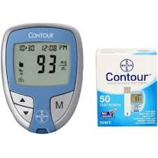
Contour Glucometer
Bayer Glucometer Strips MTI#: 0019647
Bayer Low QC MTI#: 0019777
Bayer High QC MTI#: 0019778
Lancets MTI#: 0019624
QC must be performed everyday patient testing is performed!
Bayer Quality Control solution stability ~
6 months from the date opened. Record the new expiration date on bottle.
Record the new expiration date in the QC log book. Do not record the original expiration on the bottle.
Ranges for Low, Normal and High are on the bottom of the strip box – don’t throw it away!!
Bayer Testing Strips stability: Unopened and open strips are good until the expiration date on the bottle as long as the cap is snapped shut and room temperature is maintained.
Critical Values must be repeated and given to the provider: <40 & >400 mg/dL

Slide 3
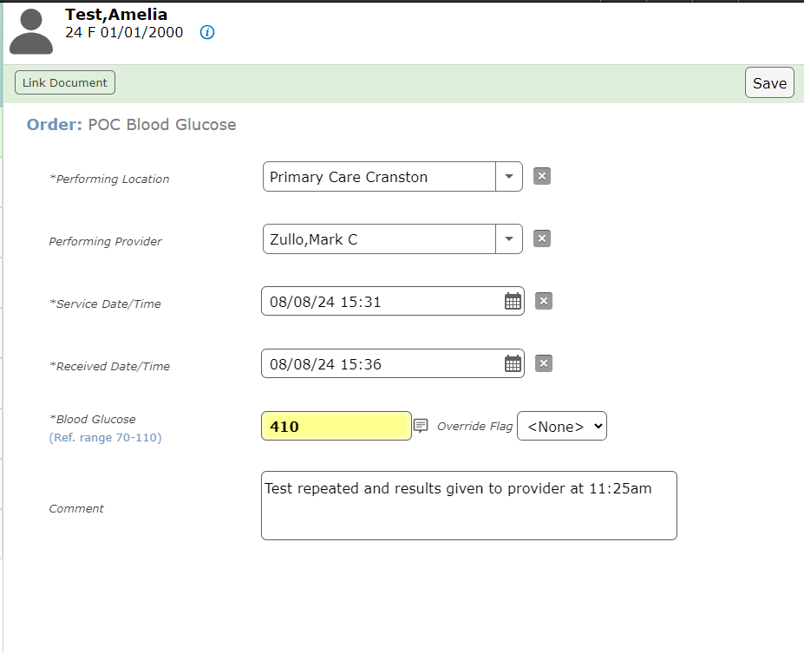
Glucose
Mnemonic: POC Blood Glucose

Slide 4
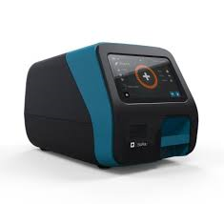
Sofia 2 influenza A&B
SARS + Flu AG Combo test
Flu A&B Ag Kit MTI#: 0027980
Flu/SARS Combo Kit MTI#: 0033897
Calibration Cassettes – Supplied by Point of Care Department
External QC~ Positive & Negative Swabs in each box.
Each new lot number
New shipment same lot number
New operator
Invalid QC needs to repeated
Recording QC
Multiple boxes of the same lot received in same shipment ~only have to perform QC on one box which is valid for all boxes.
Recording Patient Results:
Flu A/B each is either Positive or Negative, Control Acceptable.
Combo – each Flu is either positive or negative and SARS is either Presumptive Negative or Positive, Control Acceptable
Calibration – every 30 days with calibration cassette

Slide 5
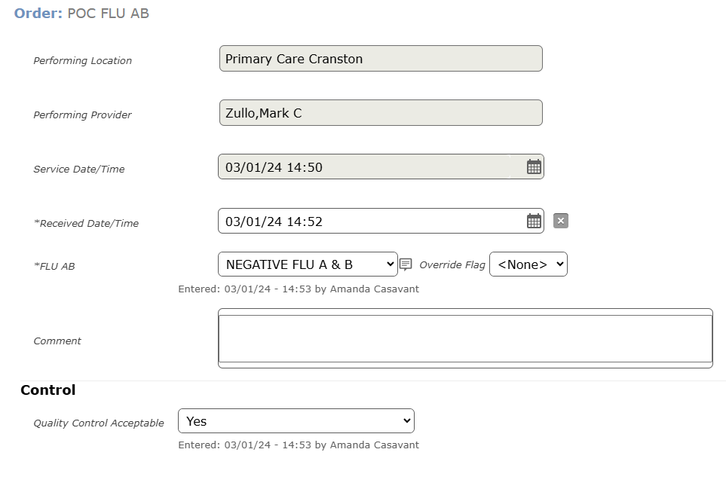
Flu A&B
Mnemonic: POC FLU AB
Always record the internal QC

Slide 6
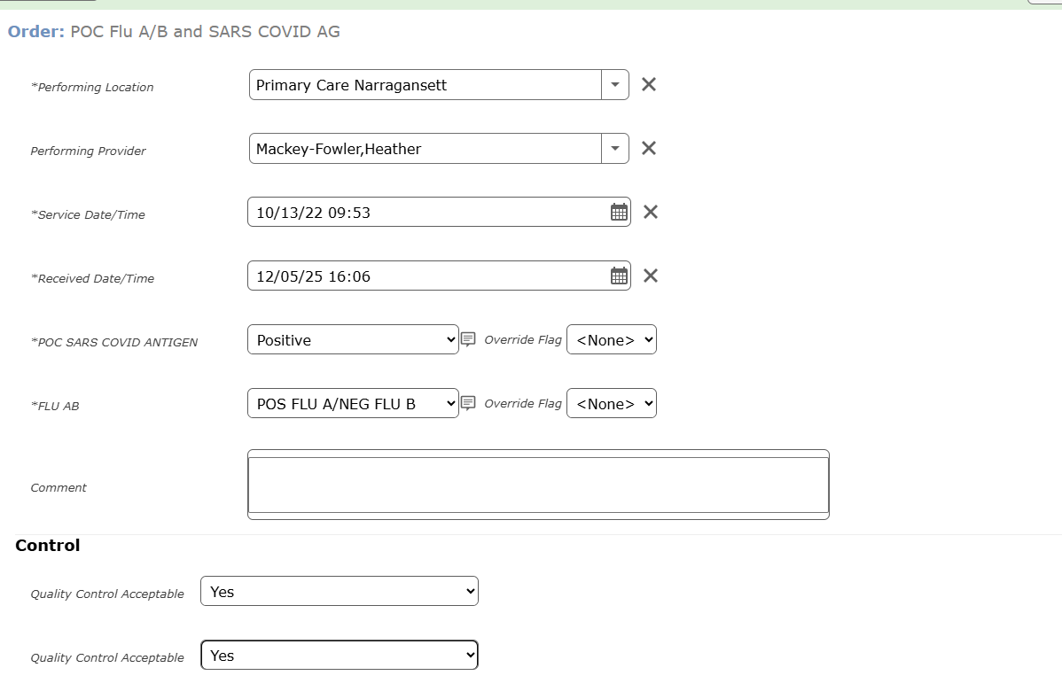

Flu A/B & SARS Ag
Mnemonic: POC Flu A/B and SARS COVID AG
Please record internal controls for both the Flus and SARS

Slide 7
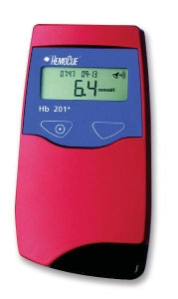
HemoCue - Hemoglobin
Hemocue Cuvettes (Individually wrapped) MTI#: 0025509
Hematrol Normal QC MTI#: 0029311
Hematrol Low QC MTI#: 002203
Lancets (Hemocue only) MTIS#: 0029744
QC
Electronic Self-Test each time it is turned and every 8 hours the meter is left on.
2 levels of QC must be run with each new lot of cuvettes, same lot new shipment, new operator and if patient results are questionable.
Performing the test:
Cuvettes must be used within 3 minutes after removal from package.
Fill the cuvette in one continuous process DO NOT refill!
Testing must occur within 10 minutes of filling the cuvette
Measuring Range: 0-25.6 g/dL
Critical Value
≤ 8 mg/dL Repeat and notify provider
Maintenance must be performed each day of patient testing.

Slide 8
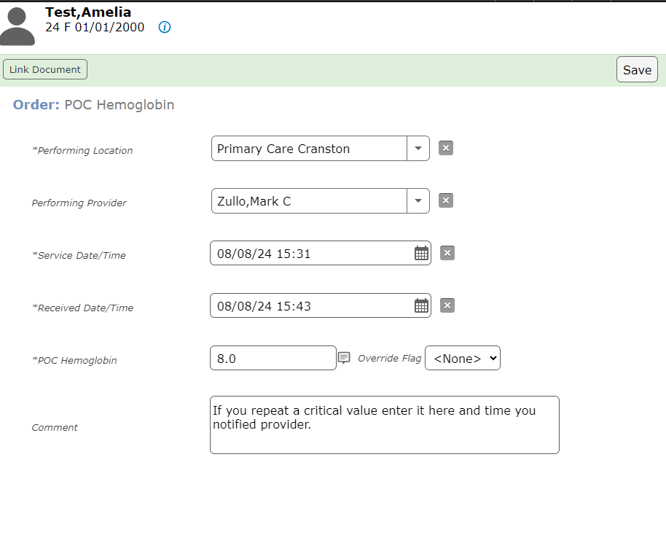
Hemoglobin
Mnemonic: POC Hemoglobin

Slide 9
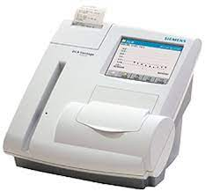

DCA Vantage A1c Analyzer
A1c Cartridges MTI#: 0032798
NOVA-One QC MTI#: 0017774
DCA Paper MTI#: 0016611
Other maintenance items – please reach out to Point of Care Coord.
A1c Kit stability – Refrigerator temp – Expiration on Box ; Room Temperature – 3 months (record the new expiration on the top of the box.
Calibration – before starting a new lot number of kit you must swipe the calibration barcode found in the box.
Upon receipt of the kits, check the temperature indicator located on the front of the carton. If the indicator dot is RED DO NOT use the cartridges. Contact the POCC for replacement.
QC – each new lot #, new shipment even if the same lot #, new operator, test results or storage of kits is questionable. ONE LEVEL EVERY 30 DAYS a box is at ROOM TEMP.
MUST start begin the test within 5 minutes of filling the capillary holder with sample or it will start to clot!
Perform all necessary maintenance listed in the Events Notification screen on the Home Screen.

Slide 10
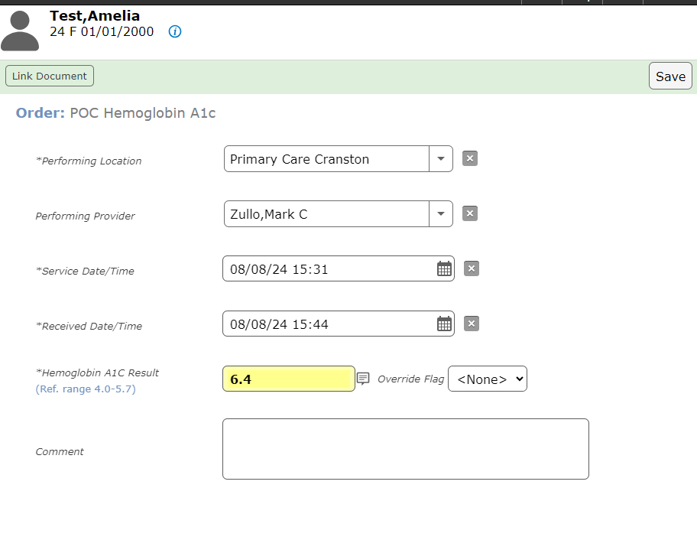
HBA1c
Mnemonic: POC Hemoglobin A1c

Slide 11
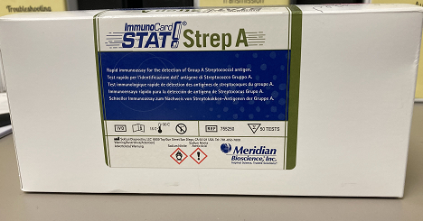
Immunocard Strep A Ag Kit
Meridian ImmunoCard Stat! Strep A Kit
E-mail Mimi Casavant first if there are free kits available they will be sent via courier.
Strep Kit MTI#: 0035723
External QC (Positive and Negative Controls in Kit) vs. Internal QC (Quality Control Monitors on the Strips)
External QC ~ new lot number, new shipment -same lot number, new operator, invalid test, storage questionable
Internal QC ~ assessed every test = line at C & Clear background
Collect specimen with swab from kit (Rayon tipped swab)
Kit and associated reagent stability~ until the expiration date on box.
Negative Rapid Tests on adolescent & Pedi patients MUST be sent to the lab for confirmatory PCR test ~ STREP (GROUP A) PCR. MUST collect another swab using the E-Swab collection swab.

Slide 12
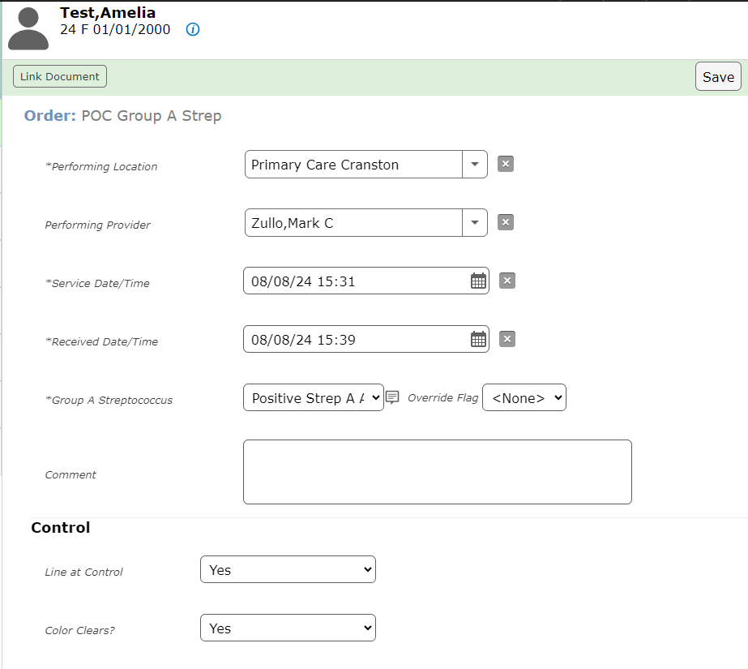
Strep Group A
Mnemonic: POC Group A Strep
Always record the internal QC

Slide 13
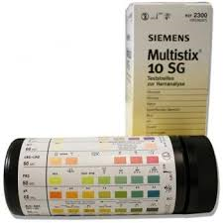
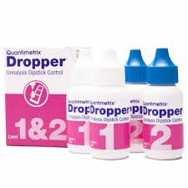
Multistix urine Dipsticks
Manual & Clinitek
Urine Dipsticks MTI#: 0000800
Quantimetrix QC MTI#: 0029989
Clinitek Paper MTI#: 0016611
External QC~
Every bottle of strips.
When strip bottle open > 30 days.
Cap left of the strip bottle.
New operator.
When results do not correlate with patient’s condition.
When Strip integrity is in question.
MAKE New QC Sheets when starting a new lot number of Dropper Plus QC ~ Highlight the ranges listed in the Dropper Plus Package insert on the QC log. Easier to see if a result is out of range. If a QC is not within range, circle and repeat it!
Maintenance must be performed and recorded each day of patient testing!

Slide 14
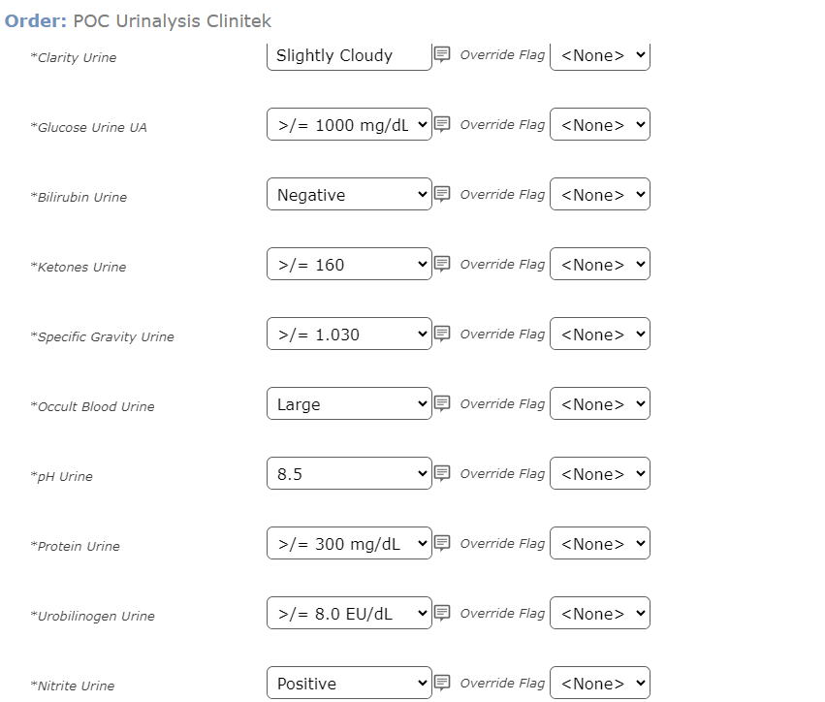
Urinalysis Clinitek
Mnemonic: POC Urinalysis Clinitek

Slide 15
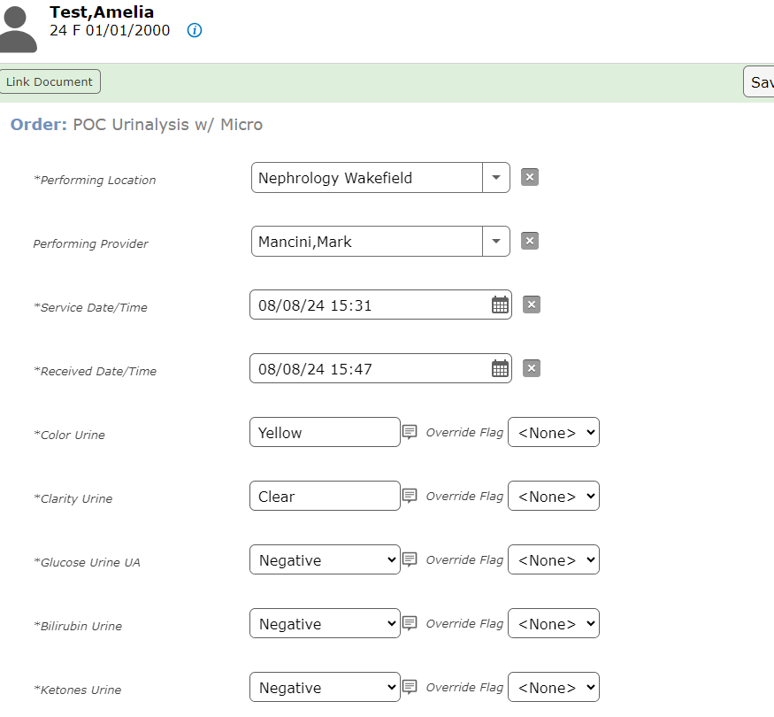
Urinalysis w/ Micro
Mnemonic: POC Urinalysis w/Micro - ONLY USED IN NEPHROLOGY

Slide 16
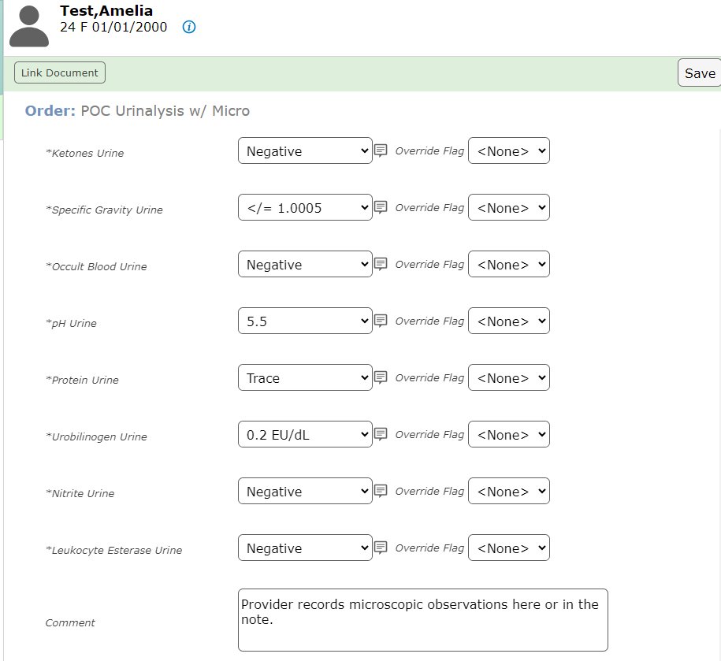
Urinalysis w/ Micro (continued)

